Slide 1
SIMPLIFYING ICD-10
For MRI Services

Slide 2
Snapshot: ICD-9 vs. 1CD-10
 | ICD-9 | ICD-10
CODES | 14,000 | 68,000
CHARACTERS | Up to 5 numeric characters | Up to 7 alpha or numeric characters
INCLUSION OF CO-MORBIDITIES | Limited inclusion of co-morbidities, complications, severity, and risk | Includes co-morbidities within codes
LATERALITY | Does not distinguish based on body part laterality (left v. right) | Includes laterality when appropriate
TIME OF EVENT | Combines initial and ensuing encounters | Separates codes for initial and subsequent visits

Slide 3

The key to ICD-10 success is
not just the code, but
the code AND the story.

Slide 4
Let’s talk ICD-10.
Q.
A.

Slide 5
“More information is needed.”
Q.
The goal of ICD-10 is provide more specific information and greater detail that will provide better data to ultimately improve the quality of patient care.
Because ICD-10 is more specific, to accurately code a diagnosis, more specific documentation will be required.
In addition to the code, we need the STORY:
  Location/laterality (ie: left, right)
  Severity of pain (severe, moderate, mild)
  Mechanism of injury
  History/context
And the clinical notes!
“What is the BIGGEST change I can expect?”
A.

Slide 6
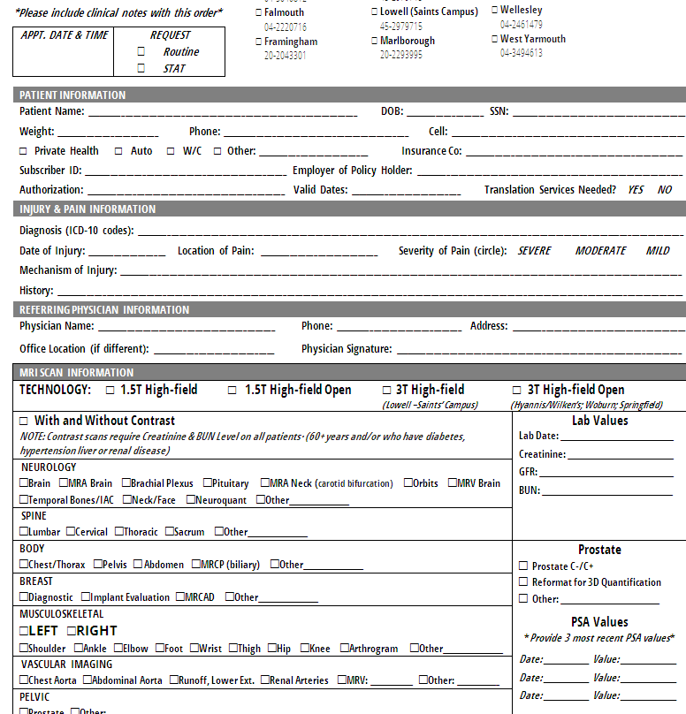
Here’s how it looks on paper

Slide 7
“No.”
Q.
The ICD-10 change doesn’t affect CPT coding for outpatient procedures.
Like ICD-9, ICD-10 are diagnosis codes.
“Does this impact CPT codes?”
A.

Slide 8
Q.
“Go to shields.com/ICD10”
Shields.com/ICD10 is an online resource with featuring an ICD-9 to ICD-10 converter.
If you are having trouble with that resource, just give us the ICD-9 code and “the story”; our scheduling team can help translate it for you.
Remember to the STORY – it’s even MORE important than the code on its own.
  Location/laterality (ie: left, right)
  Severity of pain (severe, moderate, mild)
  Mechanism of injury
  History/context
“What if I don’t KNOW
the ICD-10 code?”
A.

Slide 9
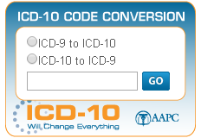
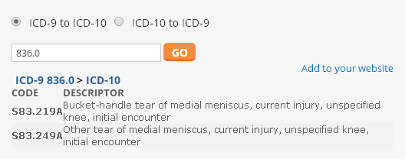
Shields.com/ICD10
Tools and resources for support on the ICD-10 transition
  Download our “cheat sheets” of top ICD-9 and
  ICD-10 conversions based on specialty
  Download this presentation for reference or office tutorials
  Use our ICD-9 to ICD-10 (and vice versa) converter
836.0

Slide 10
“Describe the pain and injury.”
Q.
If you complete the STORY, our scheduling team can help make that correction.
For example, if you order an MRI of the RIGHT shoulder, but provide the ICD-10 code for “shoulder pain, left shoulder, first incident”, your story will still look like this:
  Location/laterality: RIGHT SHOULDER
  Severity of pain: SEVERE
  Mechanism of injury: FELL OFF BIKE AND INJURED RIGHT SHOULDER
  History/context: FIRST INCIDENT
We’ll see the error, call you
to confirm, and fix it
“What if I put the INCORRECT ICD-10 code?”
A.

Slide 11
“Hmm…Sort of.”
Q.
We have two great resources to help you:
  Shields.com/ICD10 features an ICD-9 to ICD-10 converter (and vice versa). Plug in your ICD-9 and your ICD-10 options will appear. Simple!
  Shields has invested in scheduling software for our team that will help translate ICD-9 codes to ICD-10 codes
  BUT…
There is not always an exact translation. ICD-10 is a LOT more specific. Bottom line? We won’t leave you hanging. We’re here to help you and will do whatever we can to get the correct code into your order and your patient scheduled quickly.
“Can you TRANSLATE the ICD-9 code to ICD-10
for me?”
A.

Slide 12
“No way.”
Q.
Our schedulers, our coders, our reimbursement team and our radiologists are ready and prepared for ICD-10 and committed to getting your patients in quickly.
If you are having any challenges with ICD-10 ordering or feel like it might impact your patient’s appointment, contact me immediately.
You and your patients are our TOP priority.
“Will this slow down the
MRI SCHEDULING process?
A.

Slide 13
“We’re preparing to help YOU.”
Q.
When it comes to helping YOU with ICD-10, here’s what you can expect from us:
  Shields.com/ICD10
  New written order forms with a section on ICD-10 (the STORY)
  ICD-10 cheat sheets with frequently used ICD-9 codes by specialty
  New ONLINE order form coming soon
Like you, Shields is learning ICD-10 and introducing new processes internally to ensure we are set up for success. This includes:
  New technologist interview forms
  Radiologist training
  Scheduler training
  Practice tests
“What is SHIELDS MRI doing to prepare for ICD-10?
A.

Slide 14
New online order form – October 2015
New user experience
Access from shields.com homepage AND Shields Express Link
Drop-down list of doctors
Smart ICD-10 tool – it will translate it for you!
Option to “add attachment” for clinical notes

Slide 15
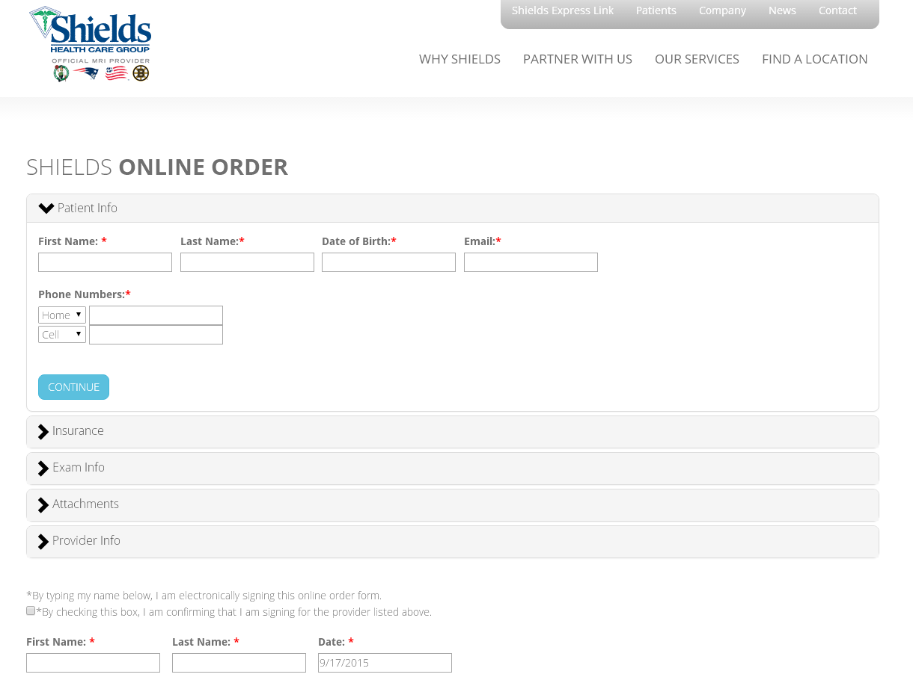

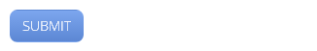

Slide 16

MSK Example:
MRI of the knee for meniscus tear
 | ICD-9 | ICD-10
 | 836.0 Tear of medial cartilage or meniscus of knee, current | S83.221A Peripheral tear of medial meniscus, current injury, right knee, initial encounter
CO-MORBIDITIES
LATERALITY
TIME OF EVENT

Slide 17
MSK Example:
MRI of the shoulder for rotator cuff sprain
 | ICD-9 | ICD-10
 | 840.4 Rotator Cuff (capsule) sprain | S43.422A Sprain of left rotator cuff capsule, initial encounter
CO-MORBIDITIES
LATERALITY
TIME OF EVENT

Slide 18
Neuro Example:
MRI of the orbits
 | ICD-9 | ICD-10
 | 368.11 Sudden vision loss | H53.131 Sudden vision loss, right eye
CO-MORBIDITIES
LATERALITY
TIME OF EVENT

Slide 19
Neuro Example:
MRI of the neck
 | ICD-9 | ICD-10
 | 784.2 Localized swelling, mass and lump head and neck | R22.1 Localized swelling, mass and lump neck
CO-MORBIDITIES
LATERALITY
TIME OF EVENT

Slide 20
Thank you!
We’re here to help.

